Slide 1
Level 6 Group 4

Slide 2
The brief
Game of Emergence
Multiple solutions
Single Player
PC

Slide 3
Demographic / Psychographic
Males
Aged 15-25
Students
Management / City simulation game

Slide 4
What the player does
Manage population
Select monster to hunt
Grow city
Upgrade units

Slide 5
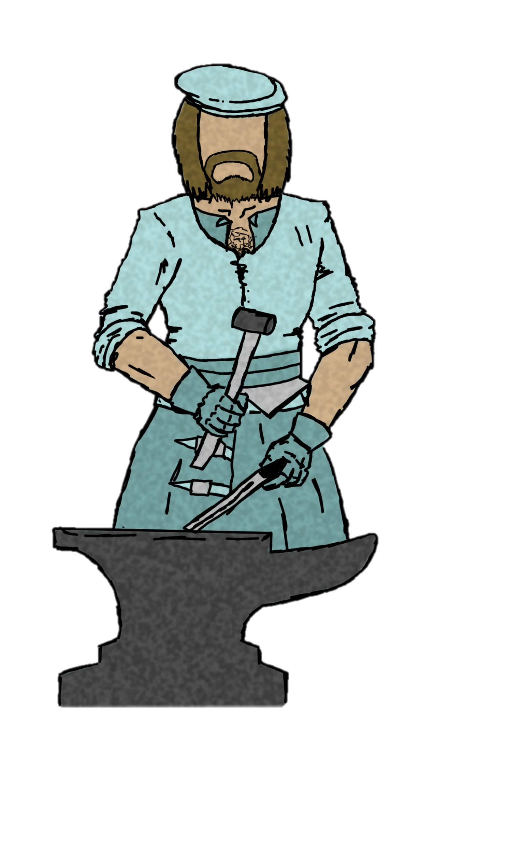
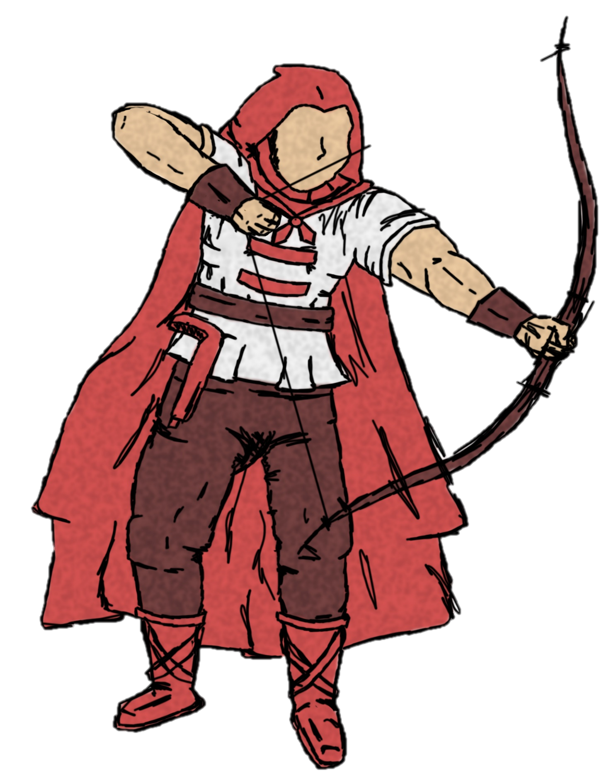
Colonists
Hunters
Scout
Blacksmith (POSSIBLY CRAFTER)
Farmer

Slide 6
Main Game loop
[insert vidya]

Slide 7
Emergence and replay ability
Rewards
Emergence
Attachment to town and NPC’s
Extrinsic and intrinsic motivation
-Extrinsic: Playing with friends, aiming for rewards.
-Intrinsic: Drive to have their ideal colony.
Notes:
Rewards must be fulfilling yet leaving the player wanting more. We will develop a reward system that is not only refreshing but keeps the player asking for more.
Emergence will be from the interactions the player has with not only his environment but the colony itself, using tropes that players can identify and latch onto such as family and friendship roles that the NPC’s will present themselves with, and the ability to assign NPC’s roles and even their names to personalize your colony and emerge the player in their own hand crafter world.

Slide 8
Art Assets (Colonists)

Slide 9
Art Assets (Buildings)

Slide 10
Art Assets (Monsters)

Slide 11
Questions?

